Slide 1
Cognitive modelling
(Cognitive Science MSc.)
Fintan Costello
Fintan.costello@ucd.ie

Slide 2
Course plan
Week 1: cognitive modelling introduction
Week 2: Our modelling area: classification in single categories and in conjunctions of those categories
Week 3: Results in conjunctive categorisation
Week 4: Overextension and the ‘guppy’ effect
Weeks 5+6: Assessing cognitive models
Week 7+8: Student presentations of their models
Weeks 9-12: Other modelling case-studies.

Slide 3
Coursework timetable
In week 3 you will be given a simple cognitive modelling assignment to do (using excel or similar).
In week 7 or 8 you will hand up your modelling assignment, and will give a 15-minute presentation in class discussing your results (these will go on the web).
In week 7 you begin a short essay (1,500 words, or around 4 double-spaced pages) comparing some different models and drawing conclusions.
You will hand this up after the easter break .
Marks will be assigned for your model and essay. There will be no exam.

Slide 4
What is a ‘model’?
A theory is a general account of how (someone thinks) a given cognitive process or area works. Theories are usually ‘informal’, stated in natural language (english), and leave details unspecified.
Theories make qualitative predictions (e.g. whether something will happen or not in different situations).
A model is a specific instantiation of a theory. Models are formally stated, in equations, computer code, or similar. Models must specify enough details to work independently.
Models make quantitative predictions (e.g. the degree to which something will happen in different situations).
Models often have parameters representing different biases or preferences. By changing the values of these parameters the model may be able to account for different people’s responses.

Slide 5
Recognising a cognitive model
Formally stated description of some cognitive mechanism;
Enough detail to be implemented independently of its creator;
Makes quantitative predictions about people’s performance when using that mechanism;
Often has parameters representing individual differences
(the model can account for different people’s performance by selecting different parameter values);
A given high-level theory can often be implemented (or instantiated) by a number of different competing models.
Structure-mapping theory of analogy
MAC-FAC model
ACME model
Sapper model
IAM model

Slide 6
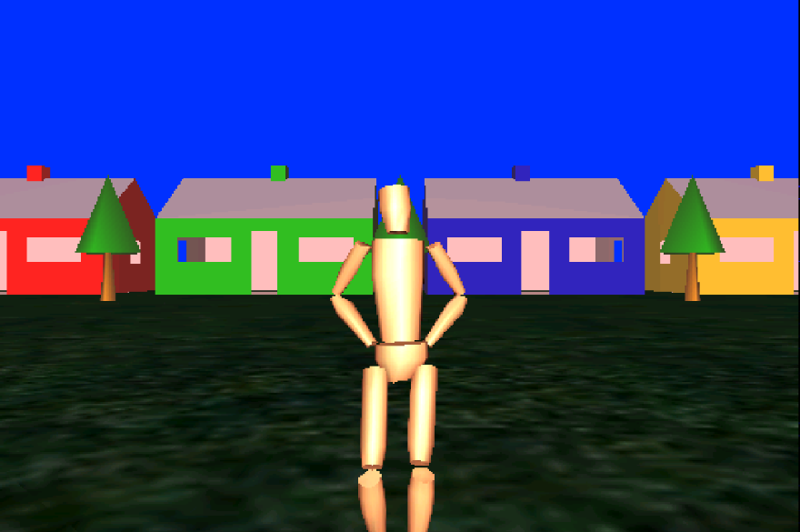
A simple example of a model
Kellleher, Costello, & Von Genabith have been working on a natural-language interface to a virtual reality system.
“go to the green house”
In this system a user types instructions, in natural language, to an “avatar” in VR space. (The user is looking from behind the avatar.)

Slide 7
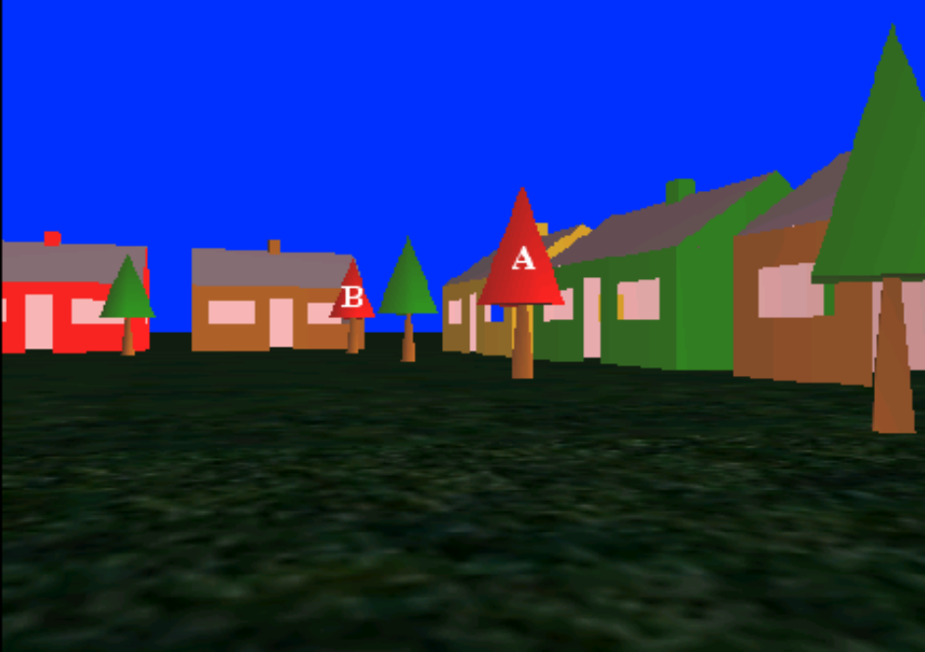
What happens with ambiguous (‘underspecified’) descriptions?
“go to the red tree”
Our theory is that, if there are two possible reference objects for a description like “the red tree”, if one object is more visually salient than the other (more visually noticable), that’s the one the user intends.
In the example above, “the red tree” is referring to tree A, not tree B (because tree A is significantly more visually salient than tree B).

Slide 8
Making a model for our theory
Above, the details of visual salience are not specified; the proposal is stated informally; and there is a qualitative prediction: if there is a big difference in visual salience between two competing referents, the intended reference object will be the more visually salient one.
To produce a model, we first make a formal statement explaining how to compute difference in visual salience between two competing referents in a scene. This will involve applying an equation (a computation) to the scene.
We then make a quantitative prediction:
If there are two competing reference objects for a description in a given scene, the probability with which people will pick the most salient as the referent for that description will be proportional to the computed difference in visual salience between those two objects.

Slide 9
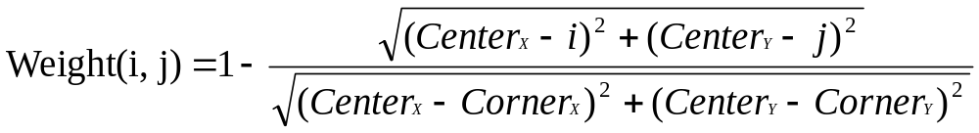

Computing visual salience: weighting pixels
To compute the visual salience of the objects in a given image, we give each pixel in the image a weighting proportional to its distance from the image center. Say the center of the image is at coordinates (Center_{X}, Center_{Y}). The weighting for pixel at coordinates (i,j) is
The closer a pixel is to the center of the image, the higher its weight is.

Slide 10
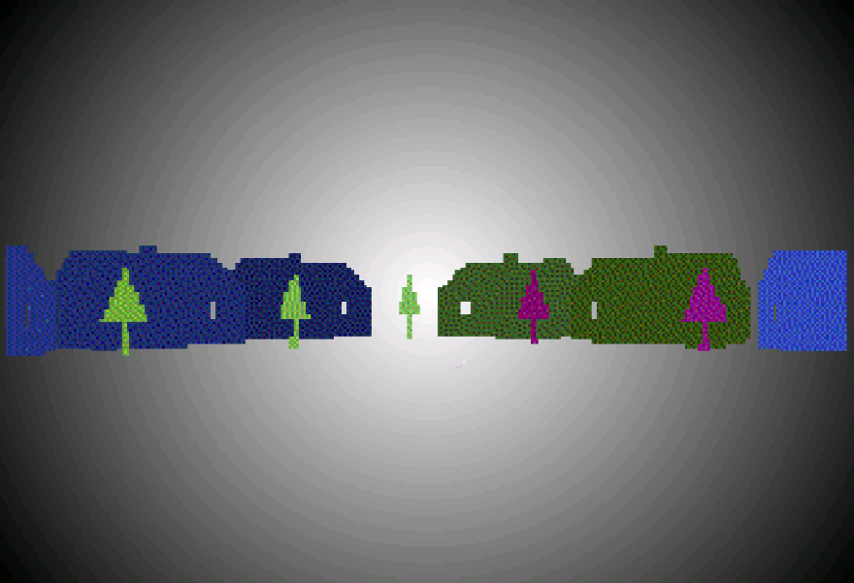
Computing visual salience: summing pixel weights
Once we’ve assigned pixel weights for every pixel in the image, we compute the visual salience for each object in the image by adding up the pixel weights of all the pixels in that object.
Objects which have a higher sum of pixel weights are more visually salient. The difference in visual salience between two objects is equal to the difference in summed pixel weights for those two objects.
In this model, the visual salience of an object is a function of its size and of its distance from the center of the image.

Slide 11
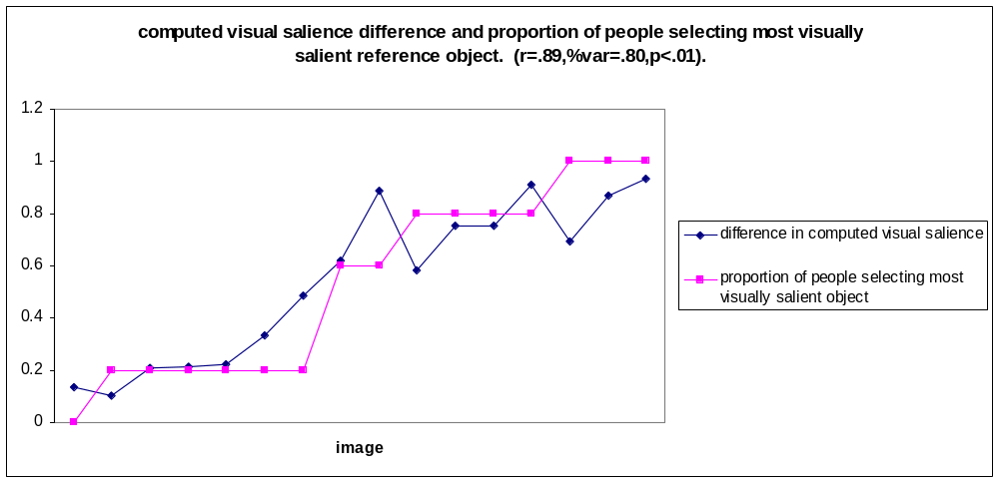
Testing the model
We can test this model by making a set of pictures with ambiguous labels (e.g. “the red tree”, where there are two red trees in the picture) and ask people to say which object the label refers to, or whether the label is ambiguous. We made a set of pictures with two target objects and a range of differences in visual salience.

Slide 12
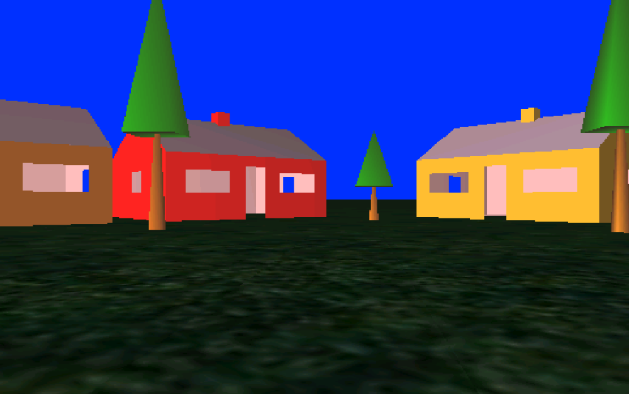
An example of what participants saw
“the tall tree”
Either click on the object which you think the phrase “the tall tree” refers to, or tick the box below if you think the phrase is ambiguous (you don’t know which object it refers to).
ambiguous

Slide 13
Another example
“the red tree”
Either click on the object which you think the phrase “the red tree” refers to, or tick the box below if you think the phrase is ambiguous (you don’t know which object it refers to).
ambiguous

Slide 14
Modelling individual participant’s responses
Each participant in our experiment either selected one of the two target objects, or selected ‘ambiguous’, for each image they saw.
To model individual participant’s responses, we use a parameter in our model: the ‘confidence interval’ parameter. We can give this parameter whatever value we liked.
If the computed visual salience difference between the two target objects in an image was greater than this interval parameter, the model would select the most salient object as the referent. If the difference was less than this parameter, the model would respond ‘ambiguous’.
We compared the model’s performance with each individual participant’s performance in the task by selecting a different value for the confidence interval when comparing the model to each participant.
This value represented the participant’s confidence in picking referents.

Slide 15
Comparing model and individual participants
Number of images for which
Number of images for which
Participant
Participant selected object
participant selected ‘ambiguous’
Model’s confidence interval
Model also selected object
Model also selected ‘ambiguous’
Participant and model did not make same choice
1
2
3
4
5
6
7
8
9
10
4
5
5
4
2
2
4
9
4
4
6
5
5
6
8
8
6
1
6
6
0.60
0.50
0.60
0.50
0.65
0.60
0.60
0.10
0.50
0.70
4
5
4
4
2
2
4
9
4
3
6
5
5
5
6
6
6
1
5
6
0
0
1
1
2
2
0
0
1
1

Slide 16
Review
A cognitive model is
A formally stated description of some cognitive mechanism;
With enough detail to be implemented independently of its creator;
That makes quantitative predictions about people’s performance when using that mechanism (numerical predictions)
That often has parameters representing individual differences
(the model can account for different people’s performance by selecting different parameter values);

Slide 17
Some other models
Cognitive modelling is a very broad area: there are cognitive models of many, many different cognitive processes.
Most models focus on one particular area of cognition. However, there have been attempts to provide ‘unified cognitive models’: general-purpose models of human cognitive processes.
We’ll have a quick look a currently popular ‘unified cognitive model’: Anderson’s ACT-R model.

Slide 18
Anderson’s ACT-R
ACT-R is intended to provide a unified model of cognition – i.e., a single system within which we can understand the wide range of cognition.
The need for such a unified model:
1. System Organization - We need to understand how the overall mental system works in order to have any real
understanding of the mind or any of its more specific
functions.
2. Mental plasticity – only by understanding the organisation of the cognitive system in general can we explain the ability to acquire new competences.

Slide 19
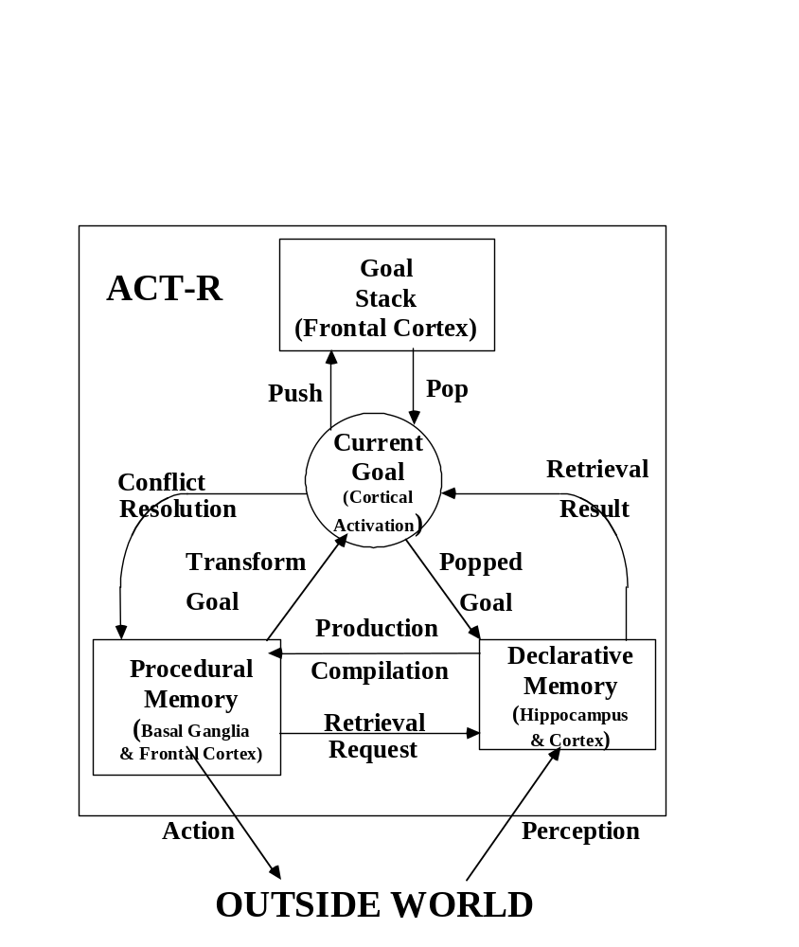
What is ACT-R
At its highest level ACT-R is a model of how ‘goals’ and ‘knowledge’ move between and are used by various components of the cognitive mechanism.

Slide 20
Chunks
ACT-R is a high-level model based on the idea of ‘chunks’ (encoded pieces of knowledge) being retrieved from declarative or procedural memory. Parameters are used to influence chunk retrieval rates and chunk formation rates (learning).
Declarative memory contains fact chunks (complex facts that have previously been important). These can be retrieved directly when required, rather than computed (deduced from simpler facts).
Procedural memory contains procedural chunks (sequences of operations that have previously been important). Again, these can be retrieved directly when needed, rather than being computed.
Retrieving a chunk is faster than computing that chunk from scratch.
Tests of ACT-R often involve comparing with people’s ability to learn and re-use chunks in a given task; in particular, their speed when carrying out certain operations (chunked or deduced).

Slide 21
Tower of Hanoi
Move all disks from ‘tower’ A to tower C. Move only one disk at a time. You are not allowed to put a disk on top of a smaller disk.
A B C
To move a tower of height 4 from A to C, just move a tower of height 3 from A to B, move the biggest disk to C, then again move a tower of height 3 from B to C.
You move a 3-height tower twice: this becomes a ‘procedural chunk’ (you don’t have to figure it out, just remember it).

Slide 22
Tower of Hanoi in ACT-R
Start-Tower
IF the goal is to move a pyramid of size n to peg x
and size n is greater than 1
THEN set a subgoal to move disk n to peg x
and change the goal to move a pyramid of size n-1 to peg x
Final-Move
IF the goal is to move a pyramid of size 1 to peg x
THEN move disk 1 to peg x
and pop the goal
Subgoal-Blocker
IF the goal is to move disk of size n to peg x
and y is the other peg
and m is the largest blocking disk
THEN post the goal of moving disk n to x in the interface
and set a subgoal to move disk m to y
Move
IF the goal is move disk of size n to peg x
and there are no blocking disks
THEN move disk n to peg x
and pop the goal
Chunk formation will happen during the execution of this algorithm; for example, in moving a 4-height tower, a procedural chunk explaining how to move a 3-height tower will be formed. This will speed up execution, particularly for some moves.

Slide 23
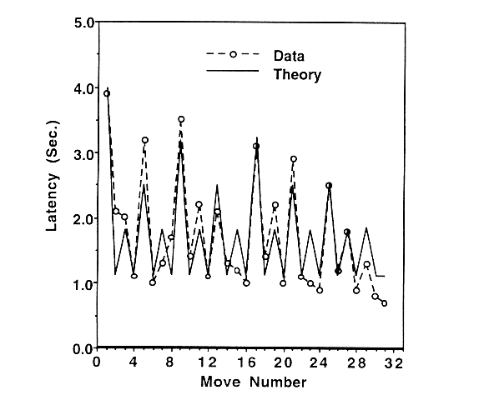
Tower of Hanoi Results
There is a good agreement between people’s delay at certain moves and their speed at other (chunked) moves, and that predicted by the ACT-R model for the tower of hanoi.
Taken from: Anderson, J.R. & Lebiere, C. (1998). The atomic components of thought. Hillsdale, NJ: LEA.

Slide 24
Areas ACT-R has been applied to
ACT-R is explicitly driven to provide models for behavioral phenomena. The tasks to which ACT-R has been applied include:
1. Visual search including menu search
2. Similarity judgments
3. Category learning
4. List learning experiments
5. Paired-associate learning
6. Individual differences in working memory
7. Cognitive arithmetic
8. Implicit learning (e.g. sequence learning)
9. Probability matching experiments
10. Hierarchical problem solving tasks including Tower of Hanoi
11. Analogical problem solving
12. Dynamic problem solving tasks including military
command and control

Slide 25
Areas ACT-R has been applied to
17. Learning of mathematical skills
18. Development of expertise
19. Scientific experimentation
20. Game playing
21. Metaphor comprehension
22. Learning of syntactic cues
23. Syntactic complexity effects and ambiguity effects
24. Dyad Communication
A priori ACT-R models can be built for new domains taking knowledge representations and parameterizations from existing domains. These deliver parameter-free predictions for phenomena like time to solve an equation.
These applications are by different researchers working in the ACT-R framework.

Slide 26
Conclusions
We’ve briefly looked at two models at very different levels; quite specific and very general.
Which level is better? The more general, the more inclusive. But the more general the more complex and perhaps the more distant from the data (there’s a danger of building ‘castles in the air’).
Next we’ll look at two different types of model for one particular task: that of classification.

